Slide 1

E_COMMERCE

Slide 2
Team: Jyothi Nalla Poonam Hatti Sagar Nathu Jedhe Parwaz Ahmed Bhukya Praveen
Mentor Name :- Dipti Sinha Ma’am

Slide 3
Problem Statement : "In the Olist e-commerce dataset, there is a need to analyze and derive actionable insights to optimize the overall performance and customer experience.” The objectives include : Understanding customer behavior, identifying key factors influencing product and seller performance, improving order fulfillment processes, and enhancing overall operational efficiency. The analysis should encompass areas such as sales trends, customer satisfaction, product categorization, and seller performance, with the ultimate goal of providing strategic recommendations for business improvement and growth within the Olist e-commerce platform."

Slide 4

About the Dataset
Set of 9 csv Datasets which Include –
olist_geolocation_dataset.csv, olist_order_items_dataset.csv, olist_order_payments_dataset.csv, olist_order_reviews_dataset.csv, olist_orders_dataset.csv, olist_products_dataset.csv, olist_sellers_dataset.csv, product_category_name_translation.csv, olist_customers_dataset.csv

Slide 5
Key Exploratory Analysis On Dataset
"The Olist dataset exhibited challenges, including 261,831 duplicates in geolocation, date format inconsistencies in order items, an outlier with 'payments_value' > 12,000 in order payments, and null values in review-related columns. The orders dataset faced null values and inconsistent date formats. Additionally, null values in various product-related columns required attention. These issues prompted specific actions to enhance data quality for analysis."

Slide 6
Actions Performed: In the Olist e-commerce dataset, several key data preprocessing actions are being performed on specific datasets. Duplicates are being removed from the 'olist_geolocation_dataset,' 'shipping_limit_date' is being converted to Date format in the 'olist_order_items_dataset,' an outlier with 'payments_value' > 12,000 is being addressed in the 'olist_order_payments_dataset.' The 'olist_order_reviews_dataset' is undergoing date format conversions and potential column drops for those with over 50% null values. In the 'olist_orders_dataset,' rows with less than 5% NA values are being dropped, and dates are being formatted. Similarly, in the 'olist_products_dataset,' rows with less than 5% NA values are being removed, particularly in various product-related columns. These actions aim to enhance the quality and consistency of the data for subsequent analysis.

Slide 7
Visualization

Slide 8
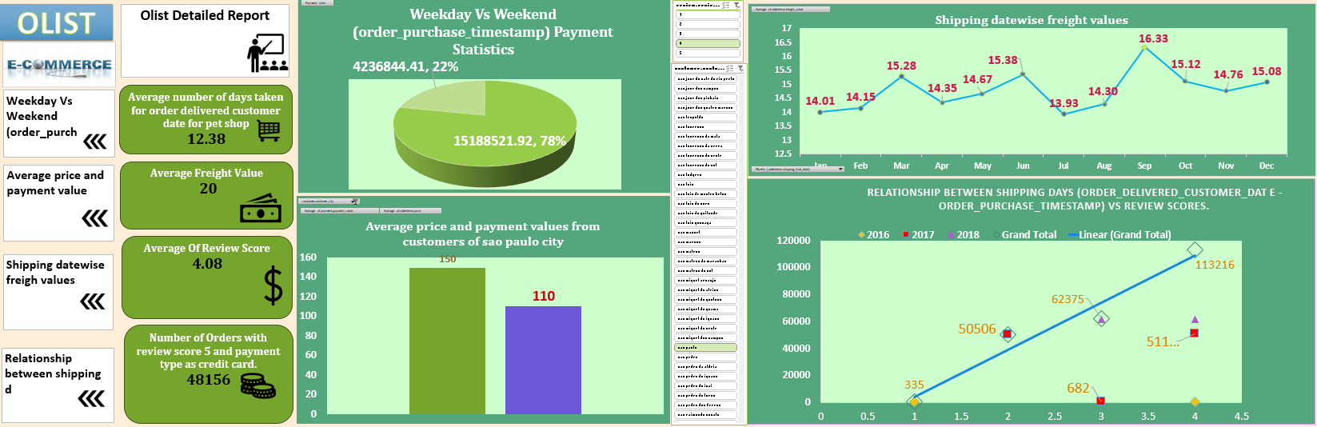

Slide 9
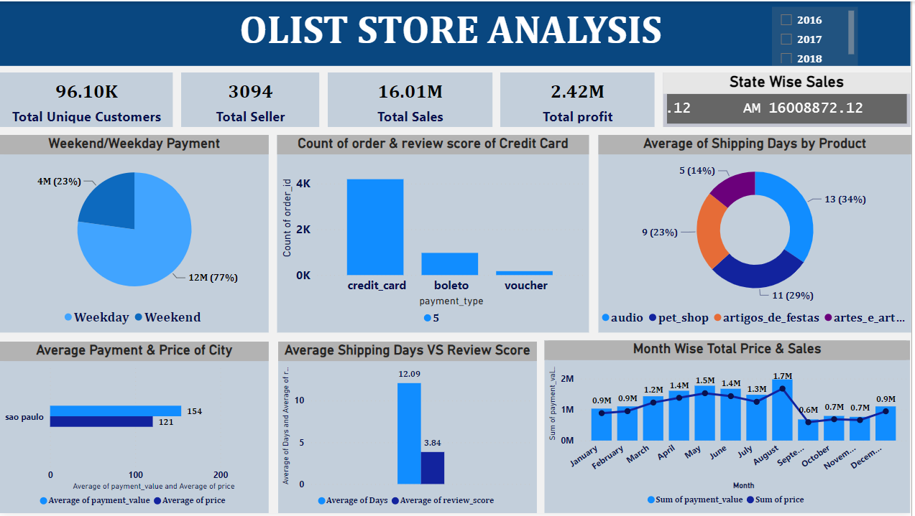

Slide 10
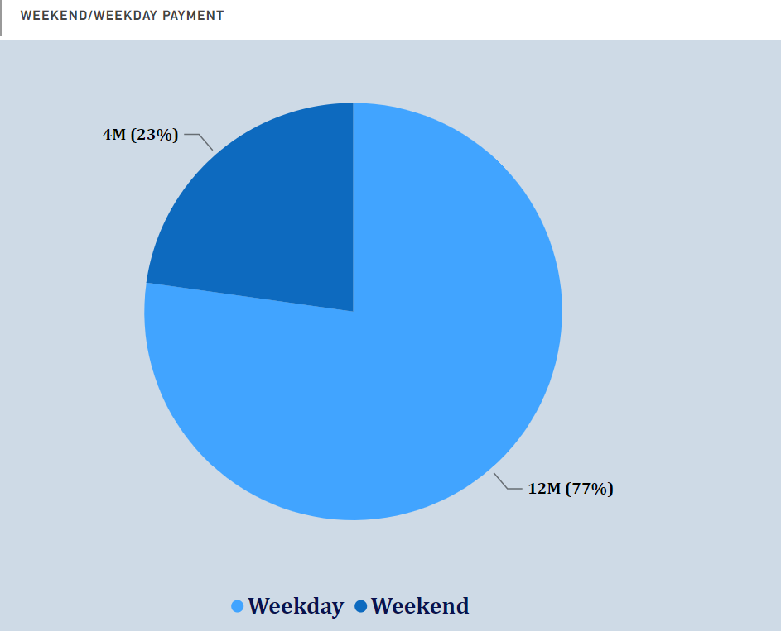
Overall: 77% of the total payment value was made on weekdays. 23% of the total payment value was made on weekends. Weekend: The pie chart slice is labeled "Weekend/Weekday Weekend". This suggests that the data might include weekend days that fall on the same calendar week as a weekday. The value of the weekend slice is 4 million, which is 22.79% of the total sum of 35,14,026.80. Weekday: The pie chart slice is simply labeled "Weekday". It has a value of 12 million, which makes up 77.21% of the total.

Slide 11
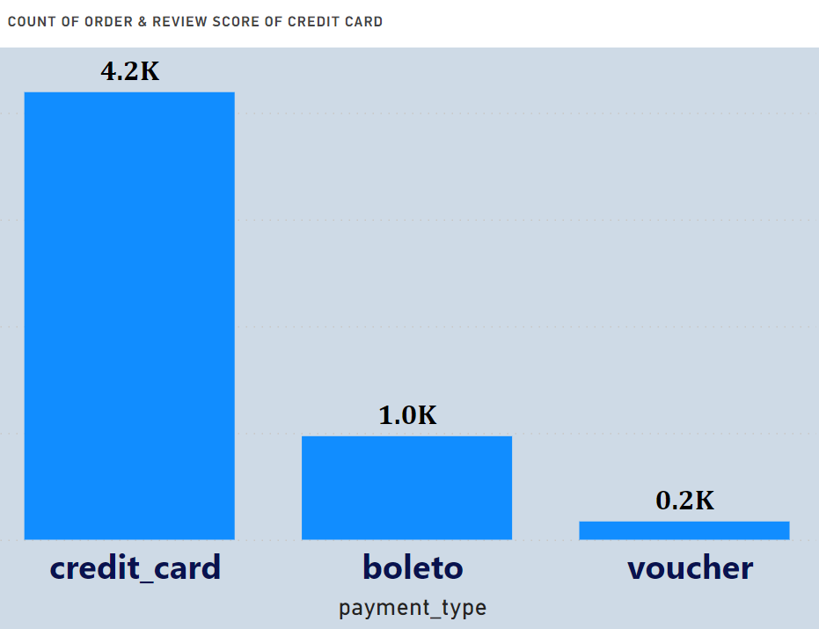
Count Of Order And Review Score of Credit Card:- Credit card payments are the most common payment type for orders with high review scores. For example, at a review score of 5.0, there are about 4,200 credit card orders, compared to only about 1,000 boleto orders and 200 voucher orders. Boleto payments are more common than voucher payments for orders with lower review scores. For example, at a review score of 1.0, there are about 100 boleto orders, compared to only about 20 voucher orders. The overall distribution of review scores is skewed to the right, with more orders having higher review scores.

Slide 12
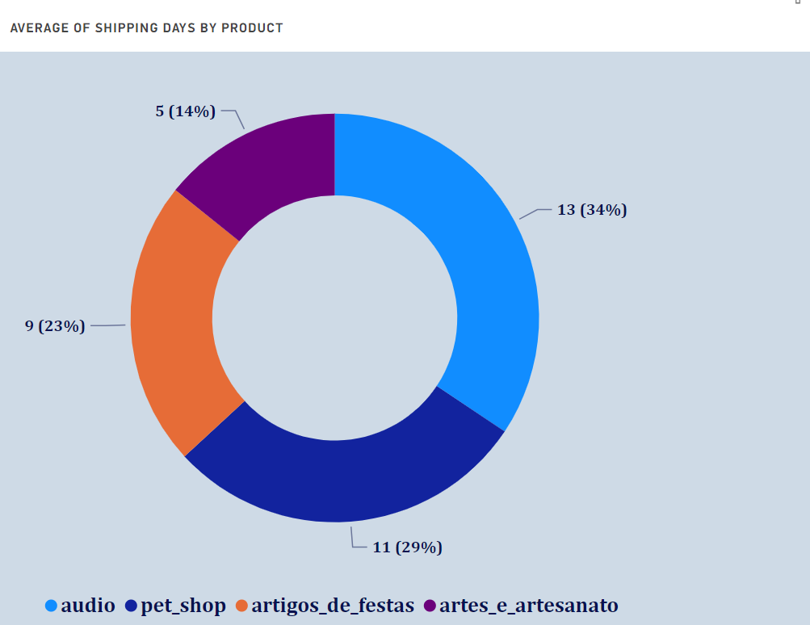
Average shipping days by Product: The average shipping days for all product categories is 5 days. Product categories: The chart shows four product categories: audio, pet shop, artigos_de_festas, and artes_e_artesanato. Shipping days by category: Audio: The average shipping days for audio products is 9 days. This slice of the pie chart makes up 23% of the total. Pet shop: The average shipping days for pet shop products is 13 days. This slice of the pie chart makes up 34% of the total. This is the largest slice of the pie chart, indicating that pet shop products have the longest average shipping days. Artigos_de_festas: The average shipping days for artigos_de_festas products is 5 days. This slice of the pie chart makes up 14% of the total. Artes_e_artesanato: The average shipping days for artes_e_artesanato products is 11 days. This slice of the pie chart makes up 29% of the total.

Slide 13
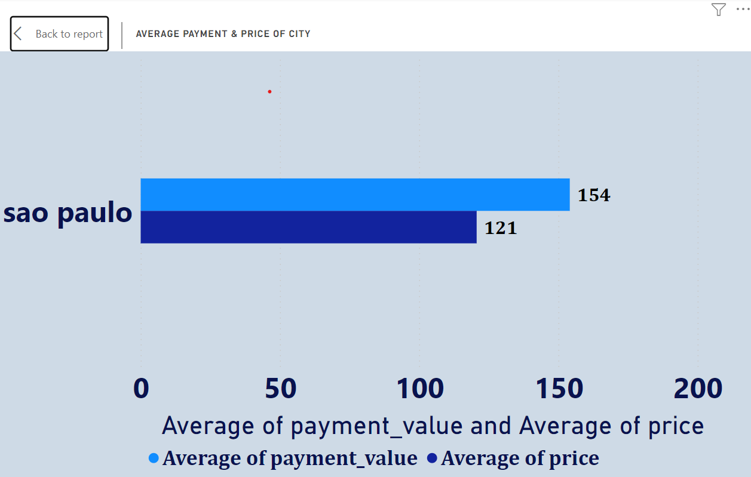
Average Payment and Price of City:- The average payment value is 154, while the average price is 121. This means that, on average, people are paying more than the asking price for apartments in Sao Paulo. The difference between the two values is 33, which represents a difference of about 27%. The chart also shows a range of values for both payment and price. The range for payment value is from 0 to 200, while the range for price is from 0 to 150. This suggests that there is a lot of variation in the prices of apartments in Sao Paulo, and that people are willing to pay a variety of prices depending on the apartment. It is important to note that this chart is based on a limited amount of data, and it may not be representative of the entire market for apartments in Sao Paulo. However, it does provide some insights into the current trends in the city's housing market.

Slide 14
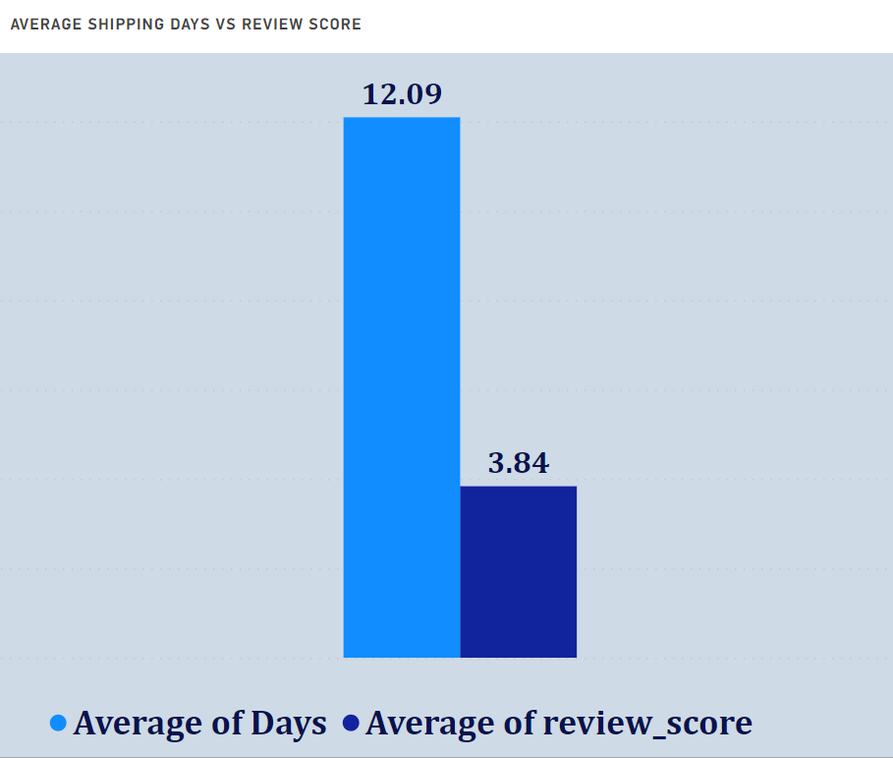
Average Shipping Days Vs Review Score:- Average shipping days: The average shipping days for all orders is 12.09 days. Average review score: The average review score for all orders is 3.84. Relationship between shipping days and review score: There is a slight negative correlation between shipping days and review score. This means that orders that take longer to ship tend to have slightly lower review scores.

Slide 15
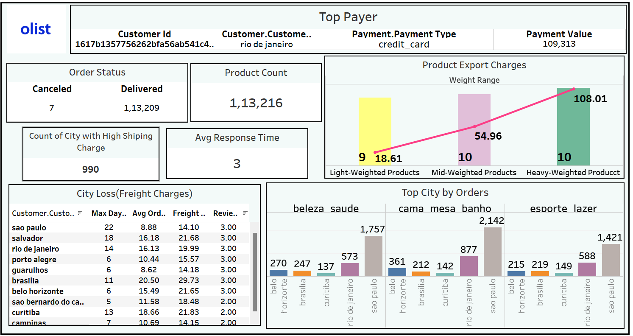

Slide 16
In Our Dataset we compared the values of orders items price and freight charges, and came to the fact that there are 990 cities which are having the freight charges more than the order items price, On analysing this fact further and sorting the data values with days travelled in the shipment of these orders are really large and considered the top ten cities to further analyse our statement and find proof. So certainly these cities placing these orders are at loss and also comparing all 3 features with review score of 3 or less than 3 they are not good as well, which is not a good impression on the context of ecommerce. We also build insights on the cities with largest purchase on products and came to know that sao Paulo city is having the most demands on products and also its on top of the city with largest no of days taken in shipment travel having a bad review. Recommendations:- So if we can reduce the freight charges and also establish some sort of storing units to reduce the days taken in travelling we can have some impact on the review score and also it might be beneficial for the ecommerce to have a hold on the customers of these Top cities with High Demand of Products

Slide 17
1) During our analysis n Excel we faced a challenge creating data model on our given data set. 2) The reviews comment and messages weren’t enough to provide a solid statement on how was the performance of the product. 3) During import of our dataset in MY SQL it took really long time for the process to complete. Also, we were faced with a challenge of renaming the columns to an appropriate format. Further more the date format was not readable at its initial import and hence we converted the format of those dates. 4) In tableau manual task of performing various visualization was a challenge itself. The issues faced in tableau and Excel were to a certain level handled in power bi( Bi directional filter).
CHALLENGES FACED DURNG PROJECT

Slide 18
Thank you

